Slide 1
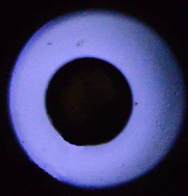
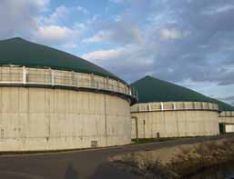
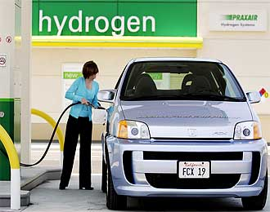

ISNTP-8, Camaret, France, 25th-29th June 2012
Hydrogen production via biomethane reforming
in DBD reactor
Mirosław Dors, Tomasz Izdebski, Artur Berendt and Jerzy Mizeraczyk
Centre for Plasma and Laser Engineering
The Szewalski Institute of Fluid-Flow Machinery Polish Academy of Sciences

Slide 2

ISNTP-8, Camaret, France, 25th-29th June 2012
Introduction
The aim
Efficient production of hydrogen from biomethane
Motivation
The growing interest in using biofuels
Is there any influence of the supply parameters on hydrogen production efficiency?
Catalyst deactivation by H₂S traces in biomethane
A few papers only on H₂ production from real biomethane using plasma methods
Centre for Plasma and Laser Engineering
The Szewalski Institute of Fluid-Flow Machinery Polish Academy of Sciences
2

Slide 3
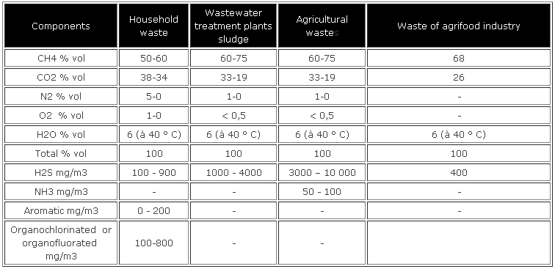
ISNTP-8, Camaret, France, 25th-29th June 2012
Biomethane – composition
Centre for Plasma and Laser Engineering
The Szewalski Institute of Fluid-Flow Machinery Polish Academy of Sciences
3

Slide 4
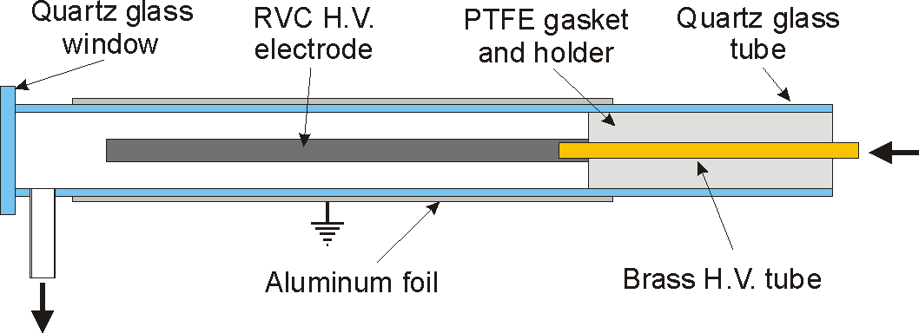
ISNTP-8, Camaret, France, 25th-29th June 2012
DBD reactor
OES
GC-TCD, FTIR
Quartz glass tube: inner diameter 15 mm
RVC (Reticulated Vitreous Carbon) electrode:
  outer diameter 8 mm,
  inner diameter 3 mm,
  length 150 mm;
  low porosity 80 ppi (pores per inch),
Gas composition and flow rate:
  CH₄:CO₂ = 70%:30%
  200 cm³/min.
OES
Centre for Plasma and Laser Engineering
The Szewalski Institute of Fluid-Flow Machinery Polish Academy of Sciences
4

Slide 5
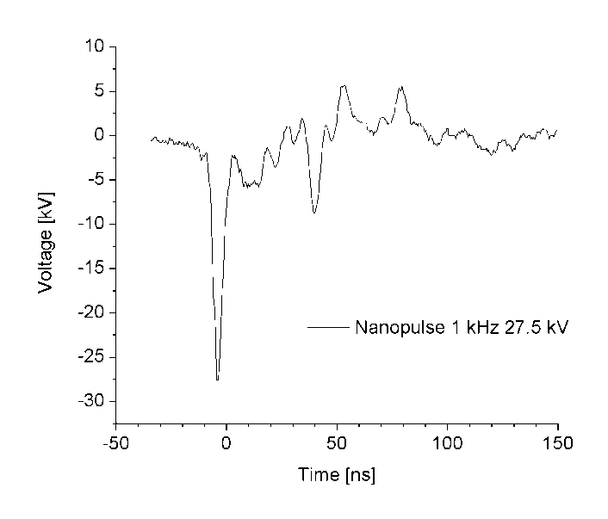
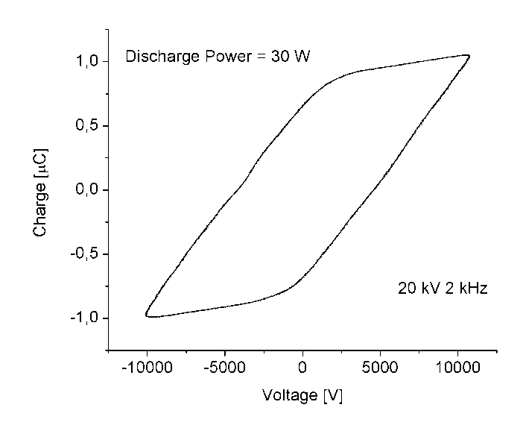


ISNTP-8, Camaret, France, 25th-29th June 2012
Power supply
AC sinusoid voltage
Function generator Tektronix AFG3101,
Amplifier TREK 40/15,
Nanosecond pulses
Pulse generator NPG-15/2000 by Megaimpulse Ltd.,
In this work: -29 kV, 50 Hz – 2.5 kHz
Frequency up to 2 kHz
In this work up to 35 kV_{p-p}
Centre for Plasma and Laser Engineering
The Szewalski Institute of Fluid-Flow Machinery Polish Academy of Sciences
5

Slide 6
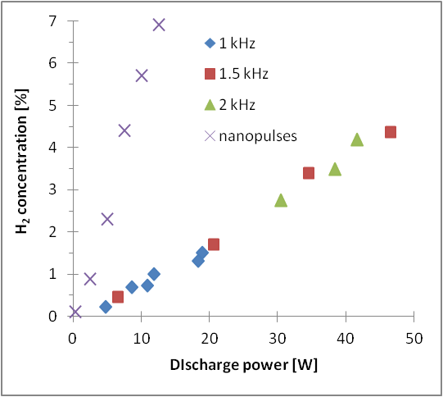
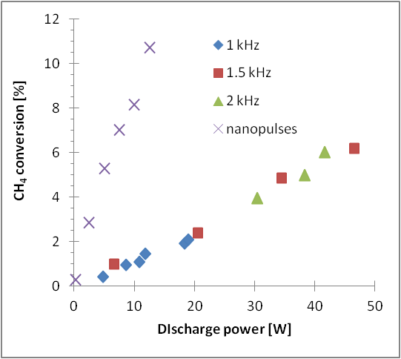
ISNTP-8, Camaret, France, 25th-29th June 2012
Results – gas composition
CH₄ + CO₂ = 2 CO + 2 H₂ ???
Centre for Plasma and Laser Engineering
The Szewalski Institute of Fluid-Flow Machinery Polish Academy of Sciences
6

Slide 7
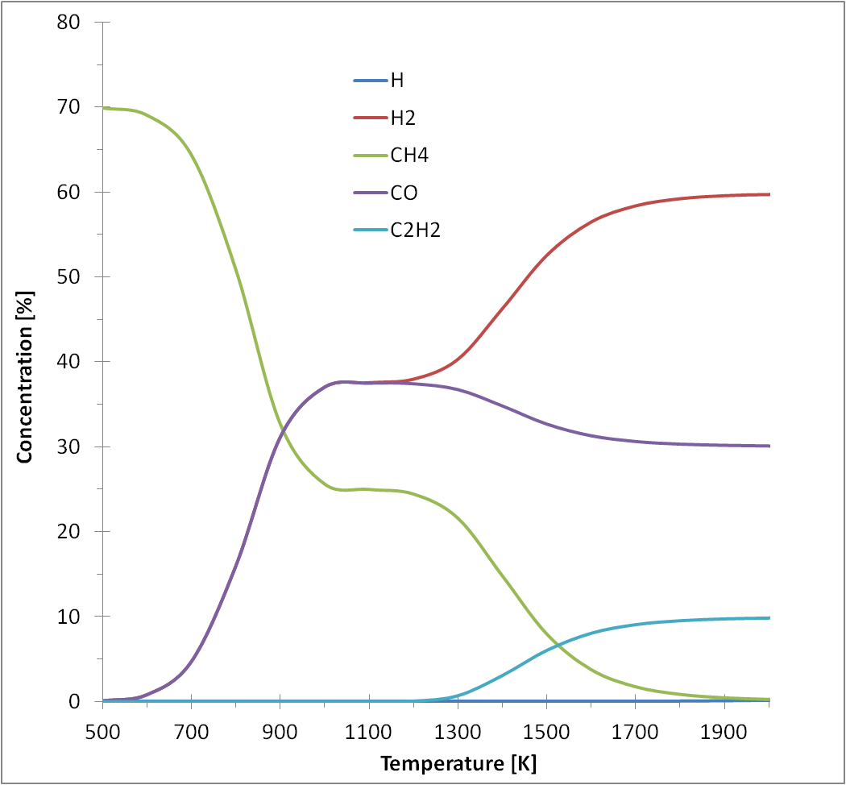
ISNTP-8, Camaret, France, 25th-29th June 2012
Results – modelling in TER
CH₄ + CO₂ = 2 CO + 2 H₂
H₂/CO=1/1
Centre for Plasma and Laser Engineering
The Szewalski Institute of Fluid-Flow Machinery Polish Academy of Sciences
7

Slide 8
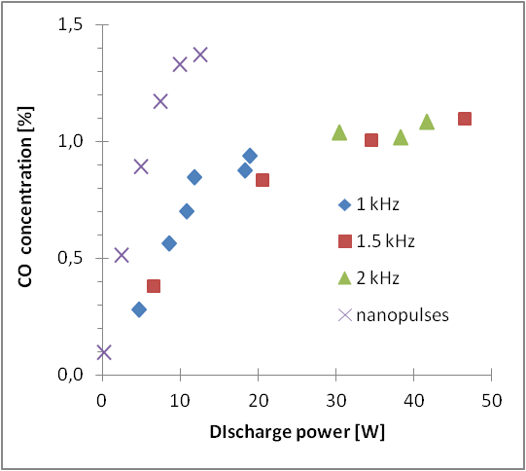
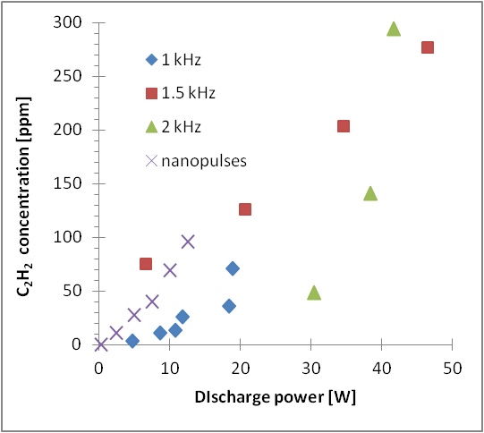
ISNTP-8, Camaret, France, 25th-29th June 2012
Results – gas composition (cont.)
close to TER
Centre for Plasma and Laser Engineering
The Szewalski Institute of Fluid-Flow Machinery Polish Academy of Sciences
8

Slide 9
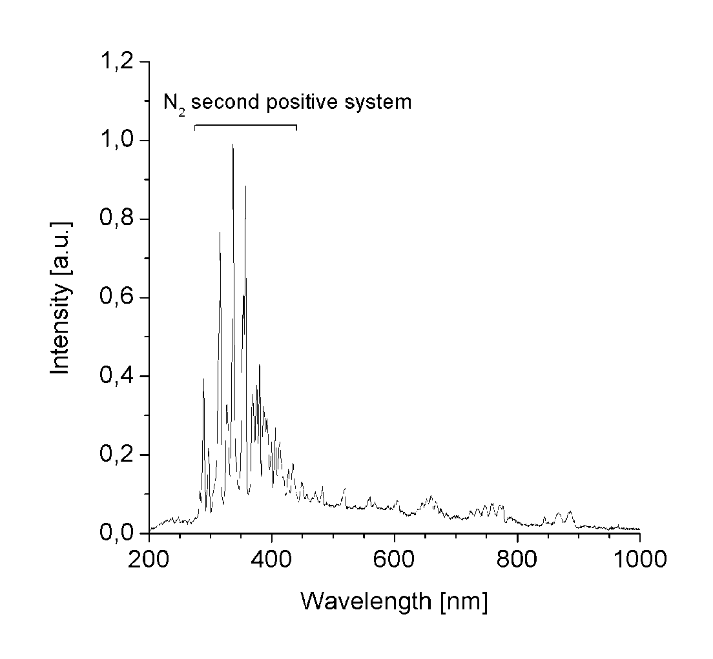
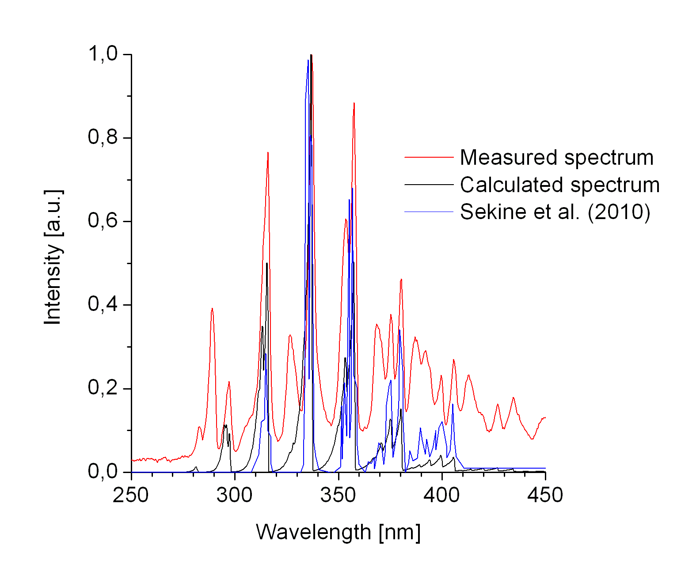
ISNTP-8, Camaret, France, 25th-29th June 2012
Results – optical emission spectroscopy
no C₂ Swan system, no CN system
no soot deposition, no changes along the reactor
Centre for Plasma and Laser Engineering
The Szewalski Institute of Fluid-Flow Machinery Polish Academy of Sciences
9

Slide 10
ISNTP-8, Camaret, France, 25th-29th June 2012
Results – summary
Centre for Plasma and Laser Engineering
The Szewalski Institute of Fluid-Flow Machinery Polish Academy of Sciences
10

Slide 11
ISNTP-8, Camaret, France, 25th-29th June 2012
Tasks in progress
H₂O admixture
H₂S admixture
Higher temperature (up to 250ºC)
Ni-catalyst
GC
FTIR
2D OES-ICCD
Centre for Plasma and Laser Engineering
The Szewalski Institute of Fluid-Flow Machinery Polish Academy of Sciences
11

Slide 12
ISNTP-8, Camaret, France, 25th-29th June 2012
Summary and conclusions
Hydrogen production and methane conversion degree increase linearly with discharge power in the range of up to 50 W
Nanosecond voltage pulses are much more efficient in hydrogen production than AC sinusoid voltage
Conversion of methane in DBD exhibits different chemistry than that typical for thermodynamic equilibrium. Where is the rest of C?
Centre for Plasma and Laser Engineering
The Szewalski Institute of Fluid-Flow Machinery Polish Academy of Sciences
12

